Slide 1
ANGULARJS (Second meeting)
Content
Discussing about exercise at first meeting (10’)
Dealing with Scope (15’)
Directive attributes (15’)
Communicating between components (30’)
Dealing with Model (10’)
Exercise 2 (10’)

Slide 2
Exercise 1 (at first meeting)
Discussing: how to do
Show example from someone

Slide 3
1) Dealing with Scope
Creating scope
Relationship types of scope

Slide 4
Creating scope
Scopes are created by directives
Controllers set up scopes
Directives is reason to create scopes
ng-controller directive create inherited scope
Directive with shared scope mode does not create scope

Slide 5
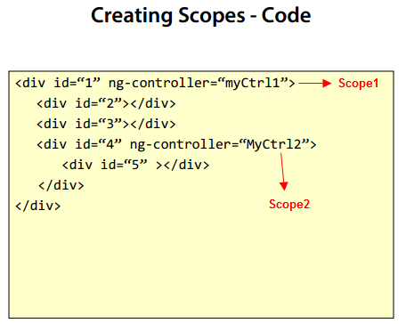
Creating scope with ng-controller
<div 5> can use properties from both myCtrl1 and myCtrl2
(inherited scope)

Slide 6
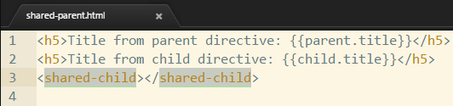
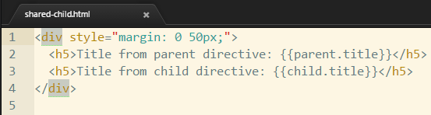
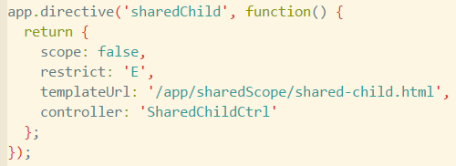
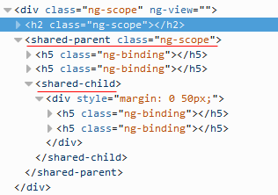
Directive with shared scope

Slide 7
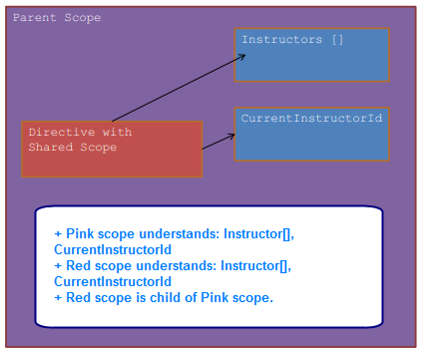
Shared scope

Slide 8
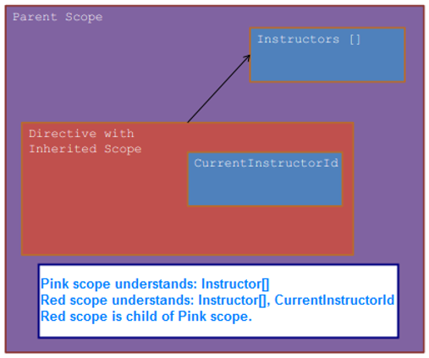
Inherited scope

Slide 9
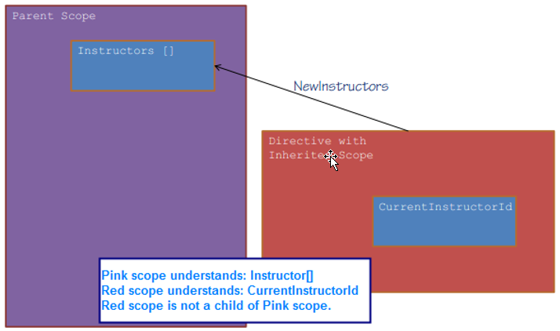
Isolated scope

Slide 10
Scope: important note
Don’t focus on scope too much. In AngularJS 2, maybe you will not see $scope.

Slide 11
2) Directive attributes
@
=
&

Slide 12
Directive attribute: @
One-way communication between parent scope into directive’s isolated scope.
Can use literal string or expression as parameter
Attribute string binding

Slide 13
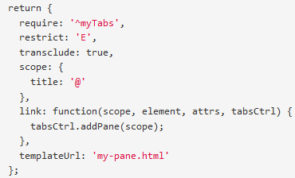
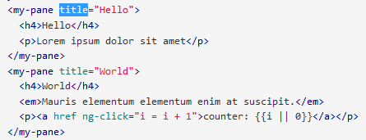
Directive attribute: @

Slide 14
Directive attribute: =
Two-way binding expression between the directive's isolated scope and the parent scope
Changing from child scope will apply to parent scope and otherwise
Two-way model binding

Slide 15
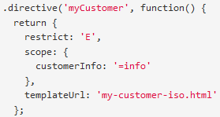

Directive attribute: =

Slide 16
Directive attribute: &
Provides a way to execute an expression in the context of the parent scope
Imaging callback
Callback method binding

Slide 17
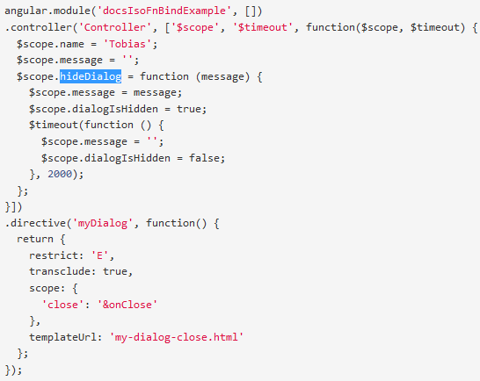
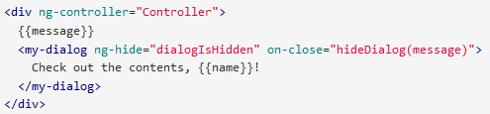

Directive attribute: &

Slide 18
II) Communicating between components (need to practice)
Using inherited scope
Using event
Using service

Slide 19
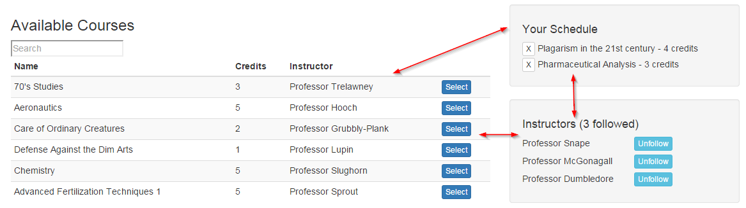
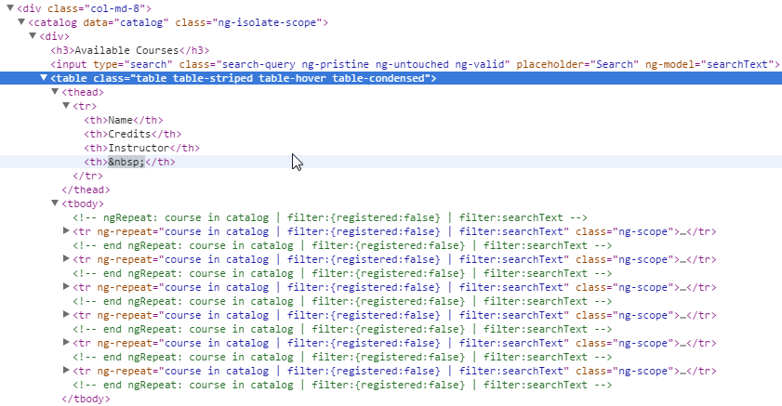
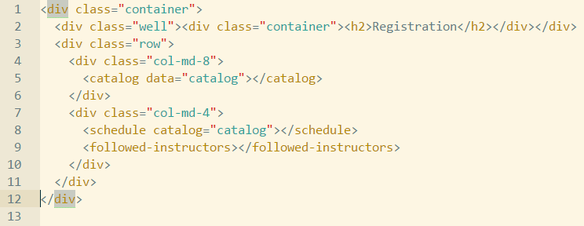
What is directive?
Normal html
Directive

Slide 20
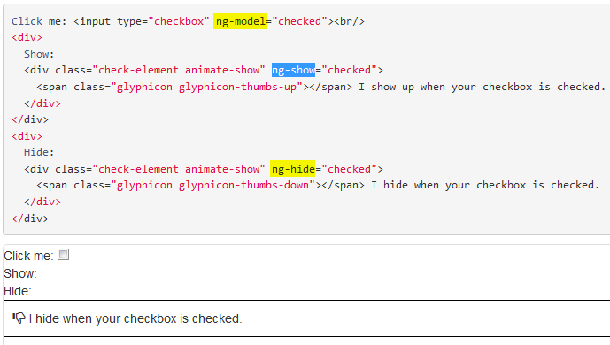
What is directive (cont)

Slide 21
When should use Directive?
Please give your idea!

Slide 22
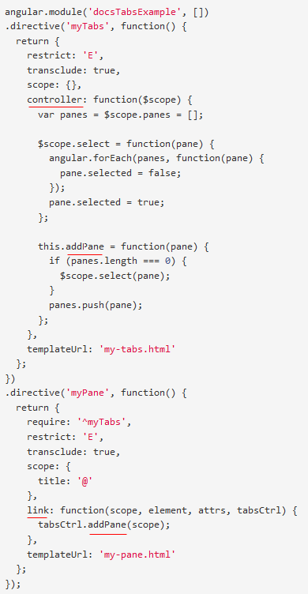
Directive: controller vs link

Slide 23
Directive: controller vs link (cont)
Best practice:
“Using controller when you want to expose an API to other directives. Otherwise use link.”

Slide 24
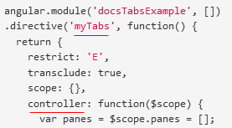
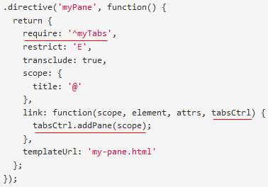
Directive: require controller(s)

Slide 25
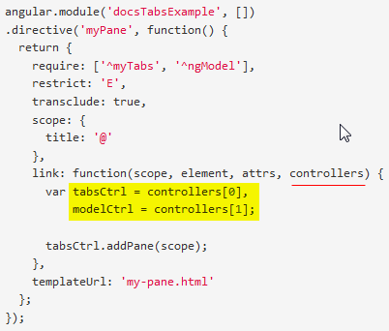
Directive: require controller (cont)
- require: 'nameOfSiblingController'
- require: '^nameOfParentController'
- require: ['nameOfSiblingController', '^nameOfParentController'] ==> multiple controllers
- require: '?nameOfController' ==> return null when can not find nameOfController instead of throw error.
- require: 'nameOfDirective' ==> Using when nameOfDirective use inner controller

Slide 26
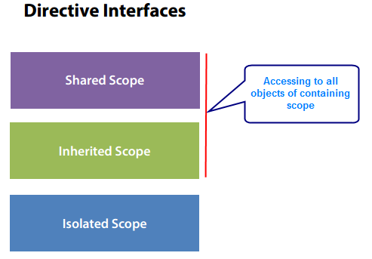
Directive interfaces

Slide 27
Directive interfaces (demo)
Parent directive ⬅ ➔ Child directive

Slide 28
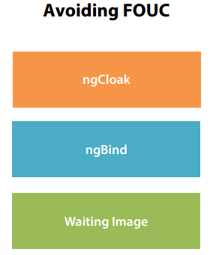
Directive: avoiding FOUC

Slide 29
Directive – Thinking declaratively (DNS)
<header>
<left-panel>
<content-panel>
<right-panel>
<customer-search>
<customer-detail>
<customer-list>
<footer>

Slide 30
III) Dealing with Model
Run webpage
Description and Requirement

Slide 31
III) Exercise 2
Run webpage
Description and Requirement

Slide 32
Q&A
Q&A

Slide 33
Thanks for joining!

